Slide 1

离散数学
Discrete Mathematics
钟芳明
离散数学
Discrete Mathematics

Slide 2
Review
Last Lecture
Propositional variable 命题变元
Compound formula 合式公式
Tautology 重言式—永真式 、Contradiction 矛盾式—永假式、Contingency 可满足式
Tautological implication 永真蕴含式
Substitution rule 代入规则
Replacement rule 替换规则
Logical equivalences 常用逻辑恒等式（30）
Tautological implications 常用永真蕴含式（16）

Slide 3
Review
Determine the output for the combinatorial circuit
Ｐ
P ∨ ¬R
R
¬R
¬P
(P ∨ ¬R) ∧ (¬P ∨ Q ∨ ¬R)
P
Q
¬P ∨ Q ∨ ¬R
R
Q ∨ ¬R
¬R
(P ∨ ¬R) ∧ (¬P ∨ Q ∨ ¬R)
Notes:
¬ ∧ ∨

Slide 4
Review
Simplify the propositional formula
(P ∨ ¬R) ∧ (¬P ∨ Q ∨ ¬R)
⇔ (P ∧ (¬P ∨ Q)) ∨ ¬R
⇔ ((P ∧ ¬P) ∨ (P ∧ Q)) ∨ ¬R
⇔ (F ∨ (P ∧ Q)) ∨ ¬R
⇔ (P ∧ Q) ∨ ¬R
P
Q
(P ∧ Q) ∨ ¬R
R
Notes:
¬ ∧ ∨

Slide 5
Review
Normal form
(P ∨ ¬R) ∧ (¬P ∨ Q ∨ ¬R)
(P ∧ Q) ∨ ¬R
Notes:
¬ ∧ ∨

Slide 6
Course Content
This Lecture
Propositions and logical connectives
Propositional variable and compound formula
Tautology, tautological implication and identity
Bring-in rule and replace rule
Duality principle (对偶原理)
Paradigm and its determination（范式及其判定）
Reasoning of propositional calculus

Slide 7
Chapter 1 Propositional Logic
1.5 Duality principle (对偶原理)

Slide 8
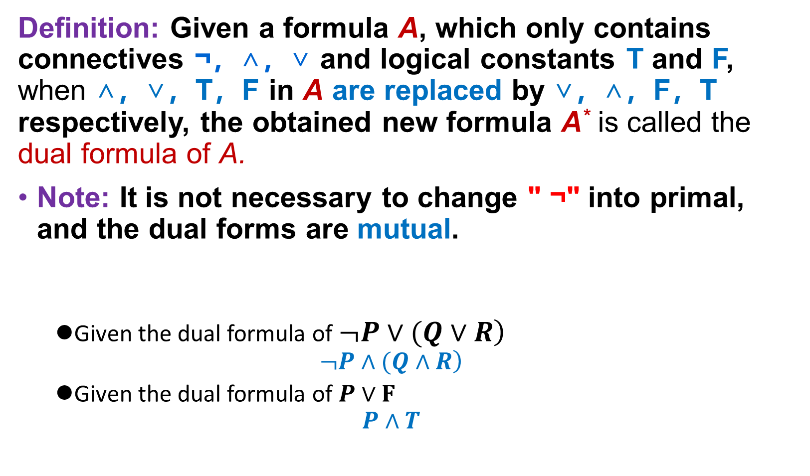
Duality principle (对偶原理)
对偶原理
定义
定理1
定理2
定理3
范式和判定
概念
析取范式和
合取范式
主析取范式和
主合取范式
Definition: Given a formula A, which only contains connectives ¬，∧，∨ and logical constants T and F, when ∧，∨，T，F in A are replaced by ∨，∧，F，T respectively, the obtained new formula A* is called the dual formula of A.
Note: It is not necessary to change " ¬" into primal, and the dual forms are mutual.
Given the dual formula of $\left.¬P∨(Q∨R\right)$
$$\left.¬P∧(Q∧R\right)$$
Given the dual formula of $P∨F$
$$P∧T$$
Example

Slide 9
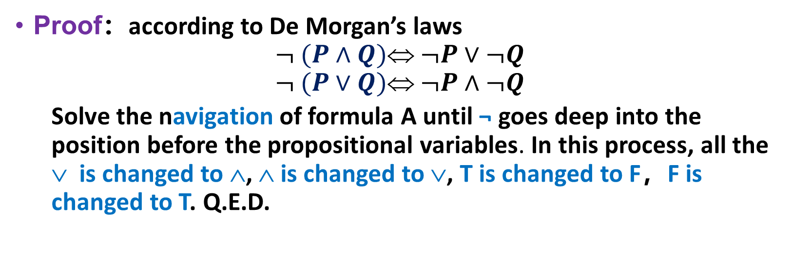
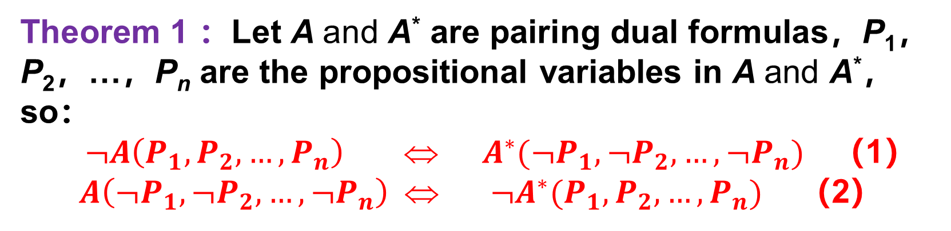
Duality principle (对偶原理)
对偶原理
定义
定理1
定理2
定理3
范式和判定
概念
析取范式和
合取范式
主析取范式和
主合取范式
Theorem 1 ：Let A and A* are pairing dual formulas，P₁，P₂，…，P_{n} are the propositional variables in A and A*，so：
$¬A\left(P_{1},P_{2},…,P_{n}\right) ⇔ { A}^{∗}(¬P_{1},¬P_{2},…,¬P_{n})$ （1）
$A\left(¬P_{1},¬P_{2},…,{¬P}_{n}\right) ⇔ ¬A^{∗}(P_{1},P_{2},…,P_{n})$ （2）
Proof：according to De Morgan’s laws
$$¬ (P∧Q) ¬P∨¬Q$$
$$¬ (P∨Q) ¬P∧¬Q$$
Solve the navigation of formula A until ¬ goes deep into the position before the propositional variables. In this process, all the ∨ is changed to ∧, ∧ is changed to ∨, T is changed to F，F is changed to T. Q.E.D.

Slide 10
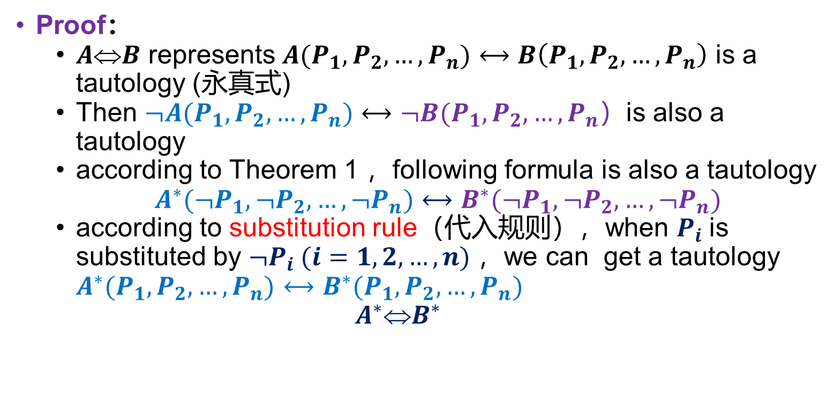
Duality theory (对偶原理)
对偶原理
定义
定理1
定理2
定理3
范式和判定
概念
析取范式和
合取范式
主析取范式和
主合取范式
Theorem 2 ：If A⇔B, and A and B are formulas are composed of propositional variables P₁，P₂，…，P_{n} and connectives ∧，∨， ¬ ，then A*⇔B*
Proof：
$AB$ represents $A(P_{1},P_{2},…,P_{n})⟷B\left(P_{1},P_{2},…,P_{n}\right)$ is a tautology (永真式)
Then $¬A(P_{1},P_{2},…,P_{n})⟷¬B(P_{1},P_{2},…,P_{n}）$is also a tautology
according to Theorem 1 ，following formula is also a tautology
$A^{∗}(¬P_{1},¬P_{2},…,¬P_{n})$ $⟷B^{∗}(¬P_{1},¬P_{2},…,¬P_{n})$
according to substitution rule（代入规则），when $P_{i}$is substituted by $¬P_{i}$ $(i=1,2,…,n)$，we can get a tautology $A^{∗}(P_{1},P_{2},…,P_{n})$ $⟷B^{∗}(P_{1},P_{2},…,P_{n})$
$$A^{∗}B^{∗}$$

Slide 11
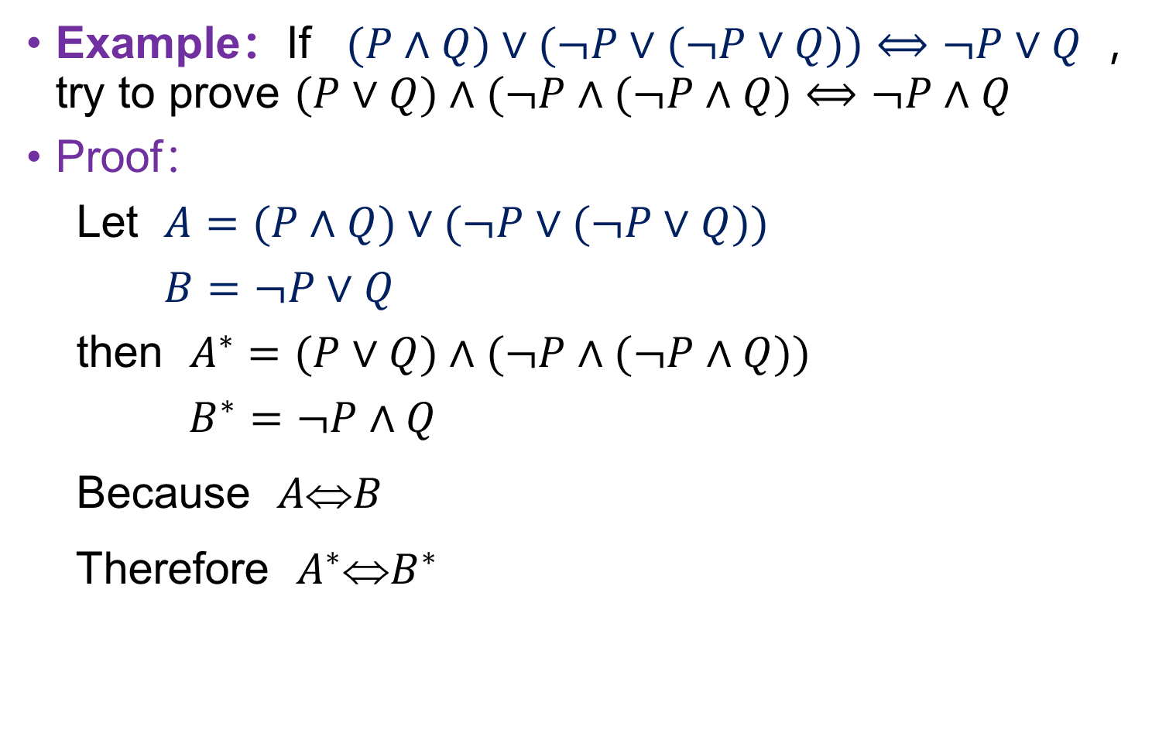
Duality principle (对偶原理)
对偶原理
定义
定理1
定理2
定理3
范式和判定
概念
析取范式和
合取范式
主析取范式和
主合取范式
Example：If $(P∧Q)∨(¬P∨(¬P∨Q))⟺¬P∨Q$，try to prove $(P∨Q)∧(¬P∧(¬P∧Q)⟺¬P∧Q$
Proof：
Let $A=(P∧Q)∨(¬P∨(¬P∨Q))$
$B=$ $¬P∨Q$
then $A^{∗}=(P∨Q)∧(¬P∧(¬P∧Q))$
$B^{∗}=¬P∧Q$
Because $AB$
Therefore $A^{∗}B^{∗}$

Slide 12
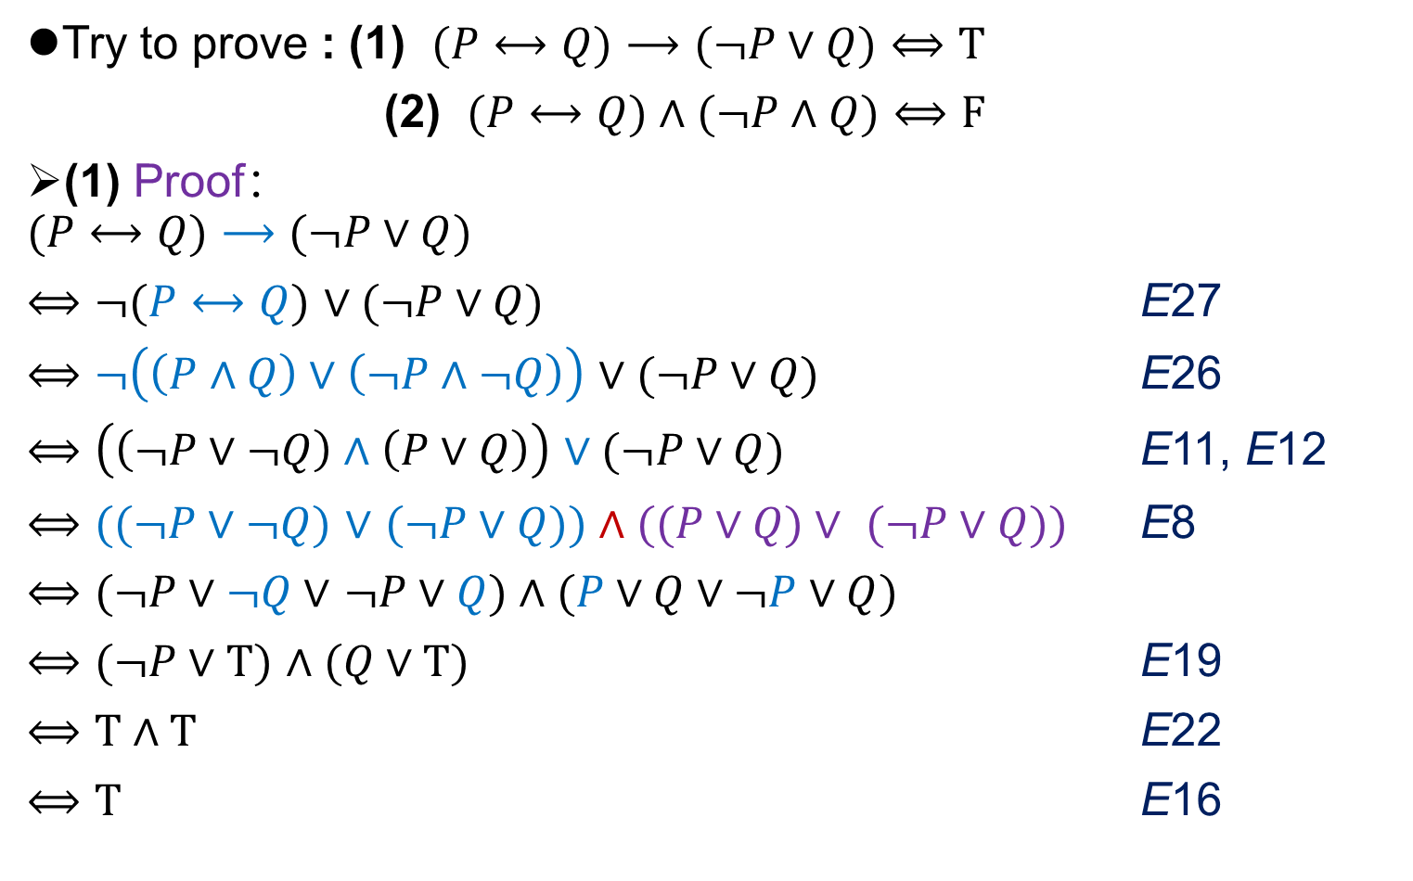
Duality principle (对偶原理)
对偶原理
定义
定理1
定理2
定理3
范式和判定
概念
析取范式和
合取范式
主析取范式和
主合取范式
Try to prove : (1) $(P⟷Q)⟶(¬P∨Q)⟺T$
(2) $(P⟷Q)∧(¬P∧Q)⟺F$
(1) Proof：
$$(P⟷Q)⟶(¬P∨Q)$$
$⟺¬(P⟷Q)$ $∨(¬P∨Q)$ E27
$⟺¬\left(\left(P∧Q\right)∨\left(¬P∧¬Q\right)\right)$ $∨(¬P∨Q)$ E26
$⟺$ $\left(\left(¬P∨¬Q\right)∧\left(P∨Q\right)\right)$ $∨(¬P∨Q)$ E11, E12
$⟺((¬P∨¬Q)$ $∨$ $(¬P∨Q))∧((P∨Q)∨ (¬P∨Q))$ E8
$⟺(¬P∨¬Q∨$ $¬P∨Q)∧(P∨Q∨¬P∨Q)$
$⟺(¬P∨T)$ $∧(Q∨T)$ E19
$⟺T∧T$ E22
$⟺T$ E16

Slide 13
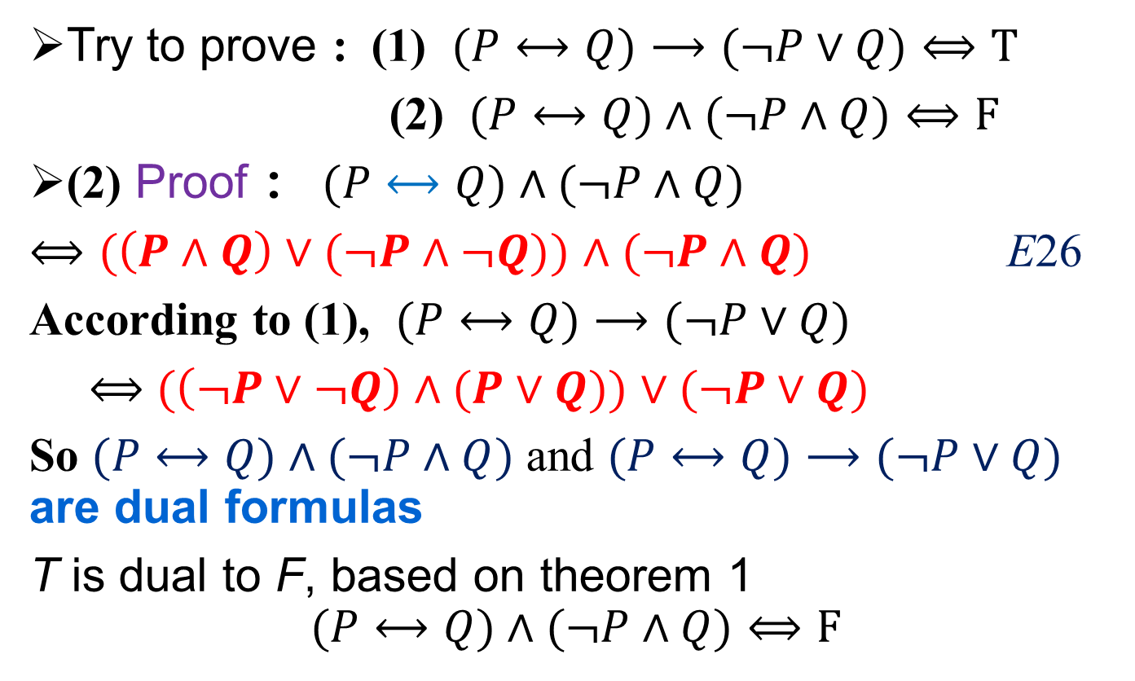
Duality principle (对偶原理)
对偶原理
定义
定理1
定理2
定理3
范式和判定
概念
析取范式和
合取范式
主析取范式和
主合取范式
Try to prove : (1) $(P⟷Q)⟶(¬P∨Q)⟺T$
(2) $(P⟷Q)∧(¬P∧Q)⟺F$
(2) Proof ： $(P⟷Q)∧(¬P∧Q)$
$⟺(\left(P∧Q\right)∨(¬P∧¬Q))$ $∧(¬P∧Q)$ E26
According to (1), $(P⟷Q)⟶(¬P∨Q)$
$⟺$ $(\left(¬P∨¬Q\right)∧(P∨Q))$ $∨(¬P∨Q)$
So $(P⟷Q)∧(¬P∧Q)$ and $(P⟷Q)⟶(¬P∨Q)$ are dual formulas
T is dual to F, based on theorem 1
$$(P⟷Q)∧(¬P∧Q)⟺F$$
Notes:
多几个步骤

Slide 14
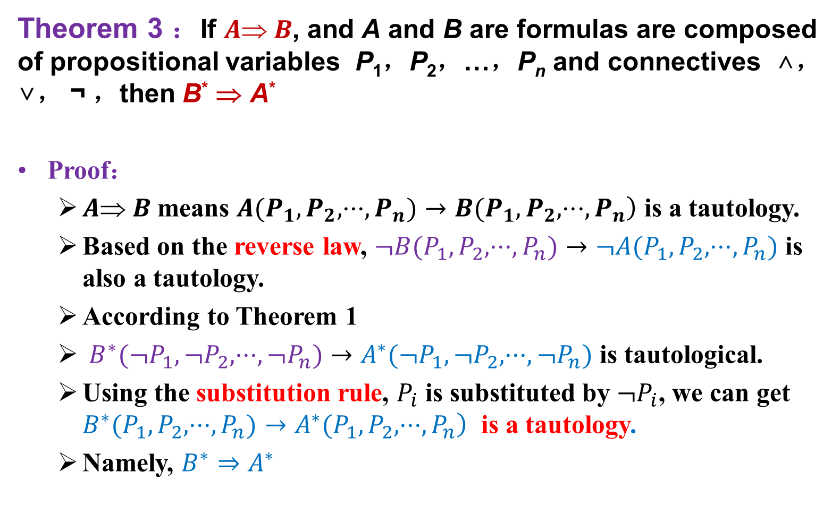
Duality principle (对偶原理)
对偶原理
定义
定理1
定理2
定理3
范式和判定
概念
析取范式和
合取范式
主析取范式和
主合取范式
Theorem 3 ：If $A B$, and A and B are formulas are composed of propositional variables P₁，P₂，…，P_{n} and connectives ∧，∨， ¬ ，then B* ⇒ A*
Proof：
$A B$ means $\left.A(P_{1},P_{2},⋅⋅⋅,P_{n})→B(P_{1},P_{2},⋅⋅⋅,P_{n}\right)$ is a tautology.
Based on the reverse law, $¬B(P_{1},P_{2},⋅⋅⋅,P_{n})→¬A(P_{1},P_{2},⋅⋅⋅,P_{n})$ is also a tautology.
According to Theorem 1
$B^{∗}(¬P_{1},¬P_{2},⋅⋅⋅,¬P_{n})→A^{∗}(¬P_{1},¬P_{2},⋅⋅⋅,¬P_{n})$ is tautological.
Using the substitution rule, $P_{i}$ is substituted by $¬P_{i}$, we can get $\left.B^{∗}(P_{1},P_{2},⋅⋅⋅,P_{n})→A^{∗}(P_{1},P_{2},⋅⋅⋅,P_{n}\right)$ is a tautology.
Namely, $B^{∗}⇒A^{∗}$

Slide 15
Chapter 1 Propositional Logic
1.6 Normal form (范式) and its judgment

Slide 16
Normal form (范式)
对偶原理
定义
定理1
定理2
定理3
范式和判定
概念
析取范式和
合取范式
主析取范式和
主合取范式
Standard form of the formula——Normal form
Used in the finite steps to determine the formula type. (tautology, contradiction, contingency)
(P ∨ ¬R) ∧ (¬P ∨ Q ∨ ¬R)
(P ∧ Q) ∨ ¬R

Slide 17
Disjunctive and Conjunctive normal form
对偶原理
定义
定理1
定理2
定理3
范式和判定
概念
析取范式和
合取范式
主析取范式和
主合取范式
Definition：
Product for conjunction, sum for disjunction
An elementary product (sum) is a product (sum) of the variables and their negations in a formula.
Elementary product：
Elementary sum:
Disjunctive normal form (DNF，析取范式) – a formula which is equivalent to a given formula which consists of sum of elementary products
DNF：
Conjunctive normal form (CNF，合取范式) – a formula which is equivalent to a given formula which consists of product of elementary sums
CNF：

Slide 18
Disjunctive and Conjunctive normal form
对偶原理
定义
定理1
定理2
定理3
范式和判定
概念
析取范式和
合取范式
主析取范式和
主合取范式
Theorem 1.6-1: An elementary product is permanent false if and only if it contains two factors likes P, ¬P
Proof：
(Sufficiency 充分性) For P∧¬P is permanent false and Q∧F⇔F , so the elementary product that contains P and ¬P is false.
(Necessity必要性) Proved by contradiction（反证法）:
Let the elementary product be false but not contains the form of factor P and ¬P. Then assign T to the variables without negation and assign F to the variables with negations. The truth value of the elementary product is T, which contradicts to the hypothesis.
Notes:
难点，想想真值表里面的赋值。

Slide 19
Disjunctive and Conjunctive normal form
对偶原理
定义
定理1
定理2
定理3
范式和判定
概念
析取范式和
合取范式
主析取范式和
主合取范式
Theorem1.6-2: A elementary sum is permanent true if and only if it contains two factors likes P, ¬P .

Slide 20
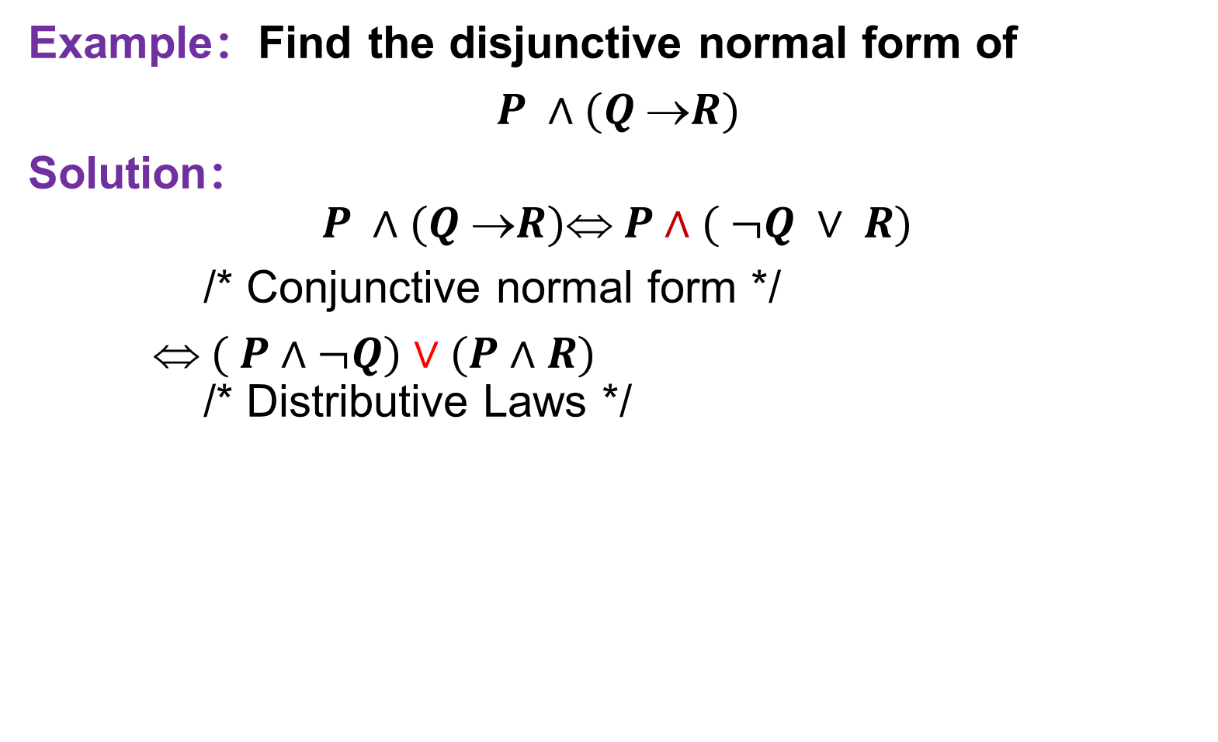
Disjunctive and Conjunctive normal form
对偶原理
定义
定理1
定理2
定理3
范式和判定
概念
析取范式和
合取范式
主析取范式和
主合取范式
Example：Find the disjunctive normal form of
$P ∧(Q R)$
Solution：
$$P ∧(Q R) P∧( ¬Q ∨ R)$$
/* Conjunctive normal form */
$ ( P∧¬Q)∨(P∧R)$
/* Distributive Laws */

Slide 21
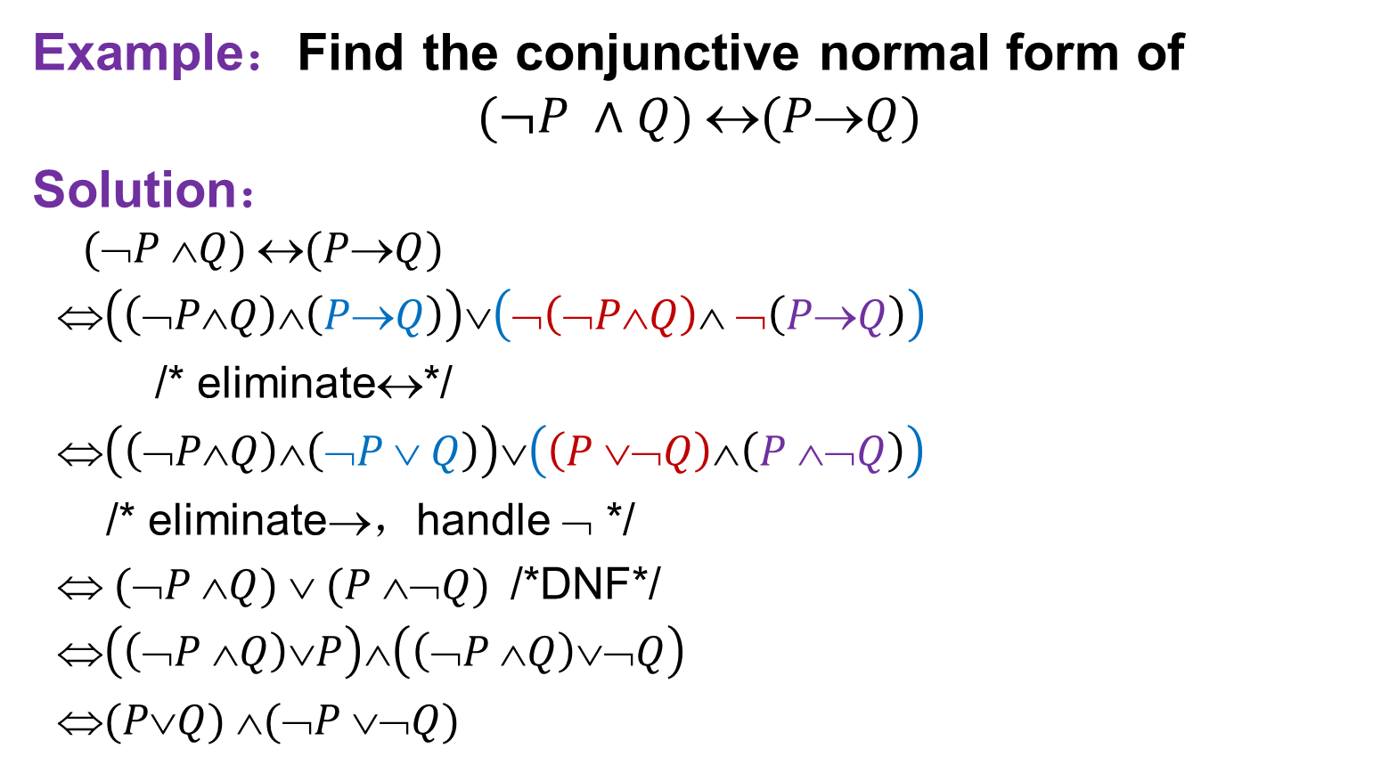
Disjunctive and Conjunctive normal form
对偶原理
定义
定理1
定理2
定理3
范式和判定
概念
析取范式和
合取范式
主析取范式和
主合取范式
Example：Find the conjunctive normal form of
$$(¬P ∧Q) (PQ)$$
Solution：
$$(➢P Q) (PQ)$$
$\left(\left(¬P∧Q\right)∧\left(P→Q\right)\right)∨\left(¬\left(¬P∧Q\right)∧ ¬\left(P→Q\right)\right)$
/* eliminate↔*/
$\left(\left(¬P∧Q\right)∧\left(¬P ∨ Q\right)\right)∨\left(\left(P ∨¬Q\right)∧\left(P ∧¬Q\right)\right)$
/* eliminate→，handle $➢$ */
$ (➢P Q)  (P ➢Q)$/*DNF*/
$\left(\left(¬P ∧Q\right)∨P\right)∧\left(\left(¬P ∧Q\right)∨¬Q\right)$
$(PQ) (➢P ➢Q)$

Slide 22
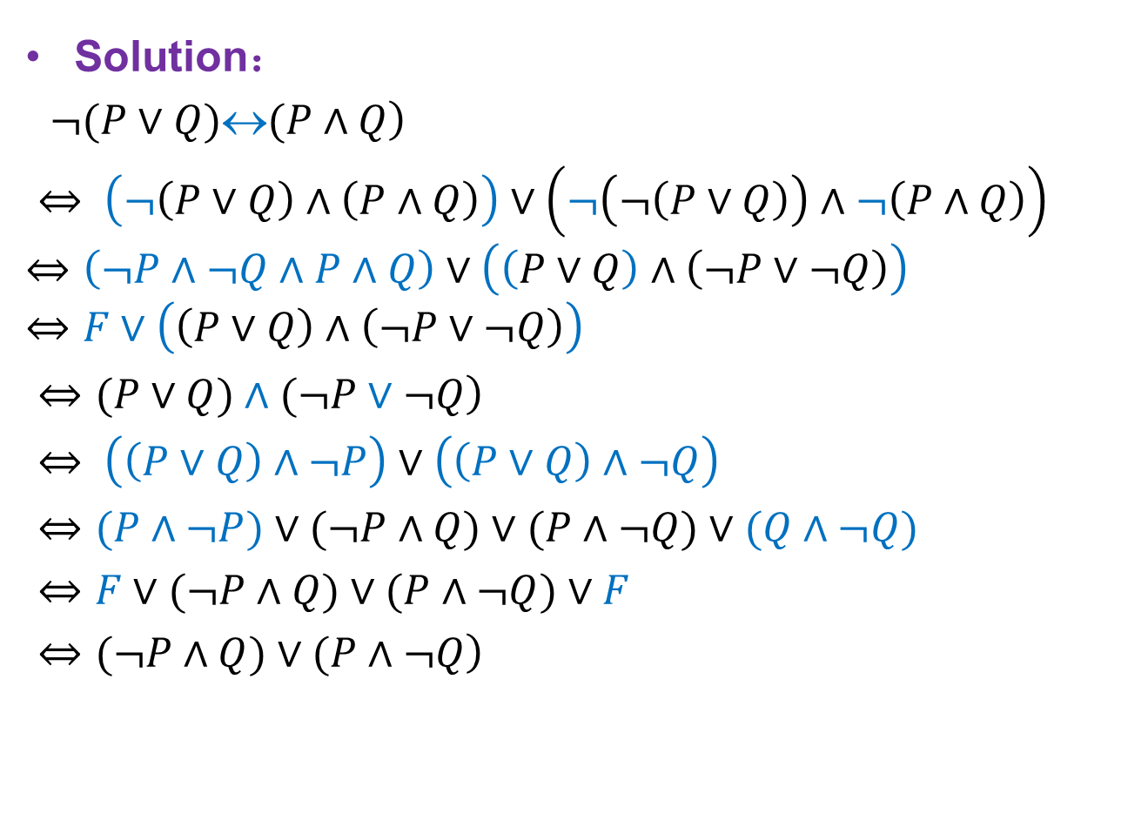

Disjunctive and Conjunctive normal form
对偶原理
定义
定理1
定理2
定理3
范式和判定
概念
析取范式和
合取范式
主析取范式和
主合取范式
Example：Find the disjunctive normal form of
$$\left.¬(P∨Q)\text{↔}(P∧Q\right)$$
Solution：
$\left.¬(P∨Q)\text{↔}(P∧Q\right)$
$⇔ \left(¬\left(P∨Q\right)∧\left(P∧Q\right)\right)∨\left(¬\left(¬\left(P∨Q\right)\right)∧¬\left(P∧Q\right)\right)$
$$⇔\left(¬P∧¬Q∧P∧Q\right)∨\left(\left(P∨Q\right)∧\left(¬P∨¬Q\right)\right)$$
$$⇔F∨\left(\left(P∨Q\right)∧\left(¬P∨¬Q\right)\right)$$
$\left.⇔(P∨Q)∧(¬P∨¬Q\right)$
$⇔ \left(\left(P∨Q\right)∧¬P\right)∨\left(\left(P∨Q\right)∧¬Q\right)$
$⇔(P∧¬P)∨(¬P∧Q)∨(P∧¬Q)∨(Q∧¬Q)$
$⇔F∨(¬P∧Q)∨(P∧¬Q)∨F$
$\left.⇔(¬P∧Q)∨(P∧¬Q\right)$
Conjunctive Normal Form

Slide 23
Principal disjunctive normal form (主析取范式)
对偶原理
定义
定理1
定理2
定理3
范式和判定
概念
析取范式和
合取范式
主析取范式和
主合取范式
Definition 1.6-4： The elementary product，in which each variable occurs either negated or nonnegated but not both，is called minterm (极小项).
Example：
The minterms for two propositional variables P and Q are:
For n variables, the number of minterms is 2^{n}

Slide 24
Principal disjunctive normal form
对偶原理
定义
定理1
定理2
定理3
范式和判定
概念
析取范式和
合取范式
主析取范式和
主合取范式
For three variables P, Q, R

Slide 25
Principal disjunctive normal form
对偶原理
定义
定理1
定理2
定理3
范式和判定
概念
析取范式和
合取范式
主析取范式和
主合取范式
Each minterm has only one truth value assignment to make it T
The conjunction of any two minterms is false
The disjunction for all minterms is true

Slide 26
Principal disjunctive normal form
对偶原理
定义
定理1
定理2
定理3
范式和判定
概念
析取范式和
合取范式
主析取范式和
主合取范式
Principal disjunctive normal form – for a given formula, an equivalent formula consisting of disjunctions of minterms only.
The equivalent principal disjunctive normal form can be obtained for any propositional formula (except the contradiction), and the form of the principal disjunctive normal form is unique.

Slide 27
Principal disjunctive normal form
对偶原理
定义
定理1
定理2
定理3
范式和判定
概念
析取范式和
合取范式
主析取范式和
主合取范式
Transform a formula to its PDNF：
Transform the formula to its DNF；
If there is some variables appearing more than once in one elementary product, it will be absorbed to once only；
Remove the elementary products that are permanent false；
If a variable P is missing from an elementary product Q, then P can be added to Q through
Q⇔T ∧ Q⇔(P ∨ ¬P) ∧ Q⇔(P ∧ Q) ∨(¬P ∧ Q)

Slide 28
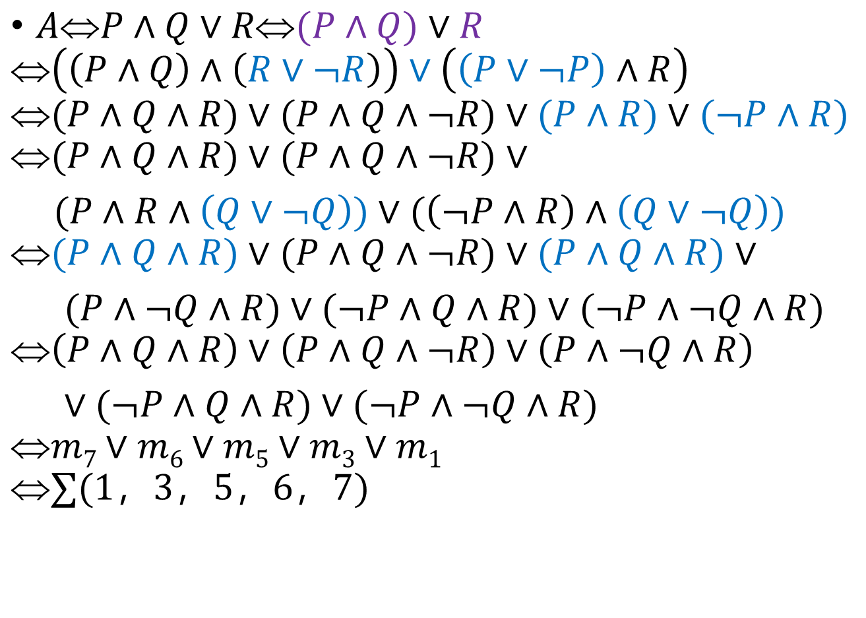
Principal disjunctive normal form
对偶原理
定义
定理1
定理2
定理3
范式和判定
概念
析取范式和
合取范式
主析取范式和
主合取范式
$AP∧Q∨R(P∧Q)∨R$
$$\left(\left(P∧Q\right)∧\left(R∨¬R\right)\right)∨\left(\left(P∨¬P\right)∧R\right)$$
$$(P∧Q∧R)∨(P∧Q∧¬R)∨(P∧R)∨(¬P∧R)$$
$$(P∧Q∧R)∨(P∧Q∧¬R)∨$$
$(P∧R∧\left(Q∨¬Q\right))∨(\left(¬P∧R\right)∧\left(Q∨¬Q\right))$
$$(P∧Q∧R)∨(P∧Q∧¬R)∨(P∧Q∧R)∨$$
$(P∧¬Q∧R)∨(¬P∧Q∧R)∨(¬P∧¬Q∧R)$
$$\left(P∧Q∧R\right)∨\left(P∧Q∧¬R\right)∨\left(P∧¬Q∧R\right)$$
$∨(¬P∧Q∧R)∨(¬P∧¬Q∧R)$
$$m7∨m6∨m5∨m3∨m1$$
$$∑(1，3，5，6，7)$$

Slide 29
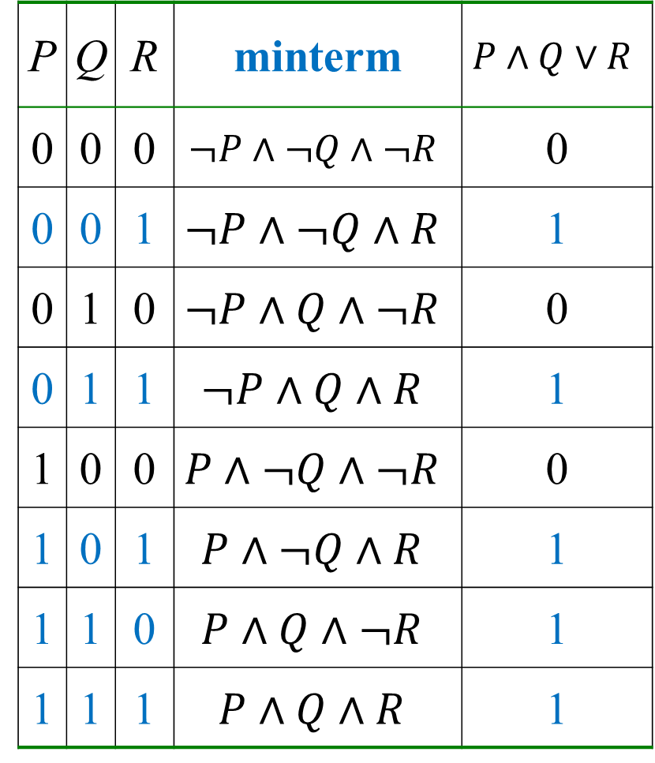
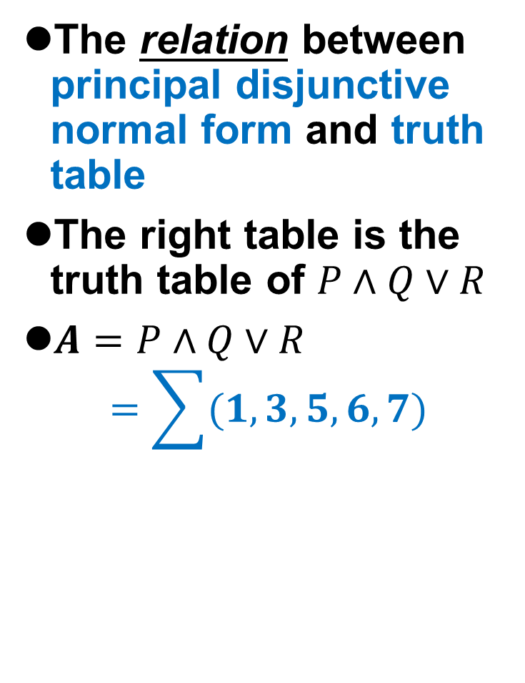
Principal disjunctive normal form
对偶原理
定义
定理1
定理2
定理3
范式和判定
概念
析取范式和
合取范式
主析取范式和
主合取范式
The relation between principal disjunctive normal form and truth table
The right table is the truth table of $P∧Q∨R$
$A=P∧Q∨R$
$$=\sum{(1,3,5,6,7)}$$
P | Q | R | minterm | $$P∧Q∨R$$
0 | 0 | 0 | $$¬P∧¬Q∧¬R$$ | 0
0 | 0 | 1 | $$¬P∧¬Q∧R$$ | 1
0 | 1 | 0 | $$¬P∧Q∧¬R$$ | 0
0 | 1 | 1 | $$¬P∧Q∧R$$ | 1
1 | 0 | 0 | $$P∧¬Q∧¬R$$ | 0
1 | 0 | 1 | $$P∧¬Q∧R$$ | 1
1 | 1 | 0 | $$P∧Q∧¬R$$ | 1
1 | 1 | 1 | $$P∧Q∧R$$ | 1

Slide 30
Principal conjunctive normal form (主合取范式)
对偶原理
定义
定理1
定理2
定理3
范式和判定
概念
析取范式和
合取范式
主析取范式和
主合取范式
Definition 1.6-6: The elementary sum, in which each variable occurs either negated or nonnegated but not both, is called maxterm(极大项).
Example：
For two propositional variables P and Q, the maximum terms are:
For n variables, the number of maxterms is 2^{n}

Slide 31
Principal conjunctive normal form
对偶原理
定义
定理1
定理2
定理3
范式和判定
概念
析取范式和
合取范式
主析取范式和
主合取范式
For three variables P, Q, R,

Slide 32
Principal conjunctive normal form
对偶原理
定义
定理1
定理2
定理3
范式和判定
概念
析取范式和
合取范式
主析取范式和
主合取范式
Each maxterm has only one truth value assignment to make it F
The disjunction of any two maxterms is true
The conjunction for all maxterms is false

Slide 33
Principal conjunctive normal form
对偶原理
定义
定理1
定理2
定理3
范式和判定
概念
析取范式和
合取范式
主析取范式和
主合取范式
Definition 1.6-7： Principal conjunctive normal form – for a given formula, an equivalent formula consisting of conjunctions of maxterms(极大项的积) only.
The equivalent principal conjunctive normal form can be obtained for any propositional formula (except the tautology), and the form of the principal conjunctive normal form is unique.
Why Tautology doesn’t have the principal conjunctive normal form?

Slide 34
Principal conjunctive normal form
对偶原理
定义
定理1
定理2
定理3
范式和判定
概念
析取范式和
合取范式
主析取范式和
主合取范式
Transform a formula to its PCNF：
Transform the formula to its CNF；
If there are some variables appearing more than once in one elementary product, it will be absorbed to once only；
Remove the elementary sums that are permanent true；
If a variable P is missing from an elementary sums Q, then P can be added to Q through
Q⇔F ∨ Q⇔(P ∧ ¬P) ∨ Q⇔(P ∨ Q) ∧(¬P ∨ Q)

Slide 35
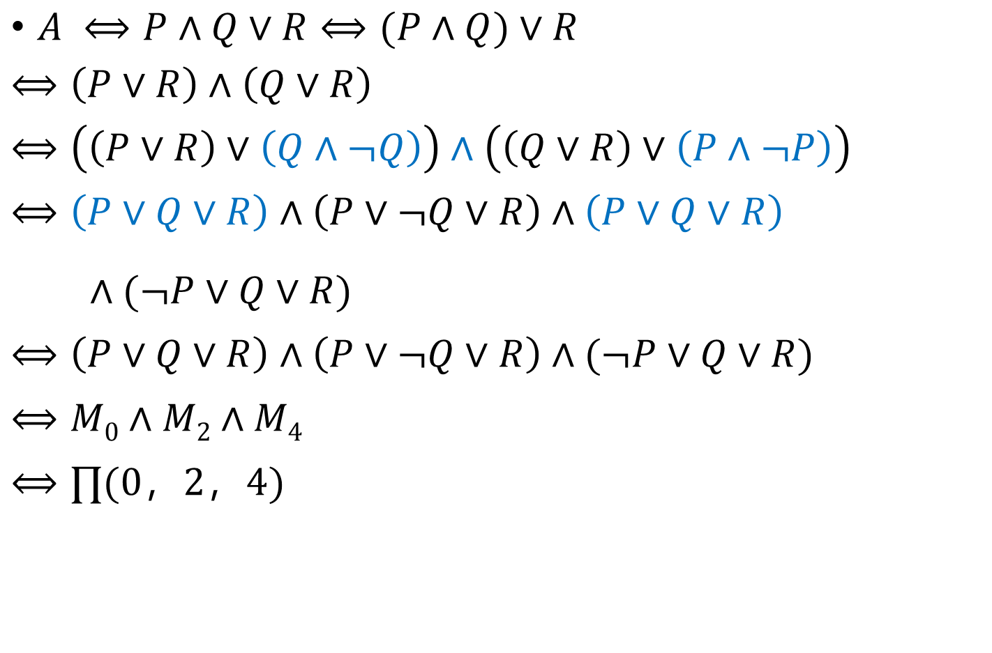
Principal conjunctive normal form
对偶原理
定义
定理1
定理2
定理3
范式和判定
概念
析取范式和
合取范式
主析取范式和
主合取范式
$A ⟺P∧Q∨R⟺(P∧Q)∨R$
$$⟺\left(P∨R\right)∧\left(Q∨R\right)$$
$$⟺\left(\left(P∨R\right)∨\left(Q∧¬Q\right)\right)∧\left(\left(Q∨R\right)∨\left(P∧¬P\right)\right)$$
$$⟺\left(P∨Q∨R\right)∧\left(P∨¬Q∨R\right)∧\left(P∨Q∨R\right)$$
$∧(¬P∨Q∨R)$
$$⟺\left(P∨Q∨R\right)∧\left(P∨¬Q∨R\right)∧(¬P∨Q∨R)$$
$$⟺M0∧M2∧M4$$
$$⟺∏(0，2，4)$$

Slide 36
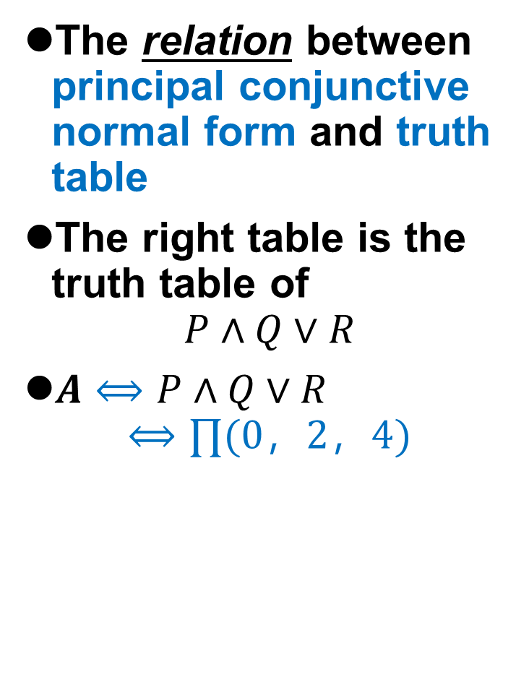
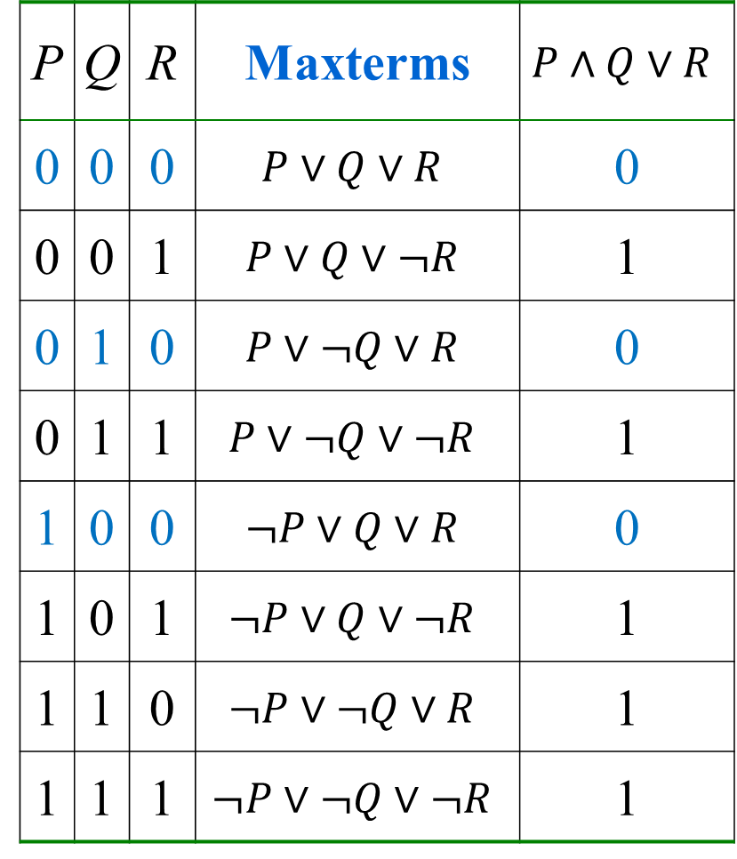
Principal conjunctive normal form
对偶原理
定义
定理1
定理2
定理3
范式和判定
概念
析取范式和
合取范式
主析取范式和
主合取范式
The relation between principal conjunctive normal form and truth table
The right table is the truth table of
$$P∧Q∨R$$
$A⟺P∧Q∨R$
$$⟺∏(0，2，4)$$
P | Q | R | Maxterms | $$P∧Q∨R$$
0 | 0 | 0 | $$P∨Q∨R$$ | 0
0 | 0 | 1 | $$P∨Q∨¬R$$ | 1
0 | 1 | 0 | $$P∨¬Q∨R$$ | 0
0 | 1 | 1 | $$P∨¬Q∨¬R$$ | 1
1 | 0 | 0 | $$¬P∨Q∨R$$ | 0
1 | 0 | 1 | $$¬P∨Q∨¬R$$ | 1
1 | 1 | 0 | $$¬P∨¬Q∨R$$ | 1
1 | 1 | 1 | $$¬P∨¬Q∨¬R$$ | 1

Slide 37
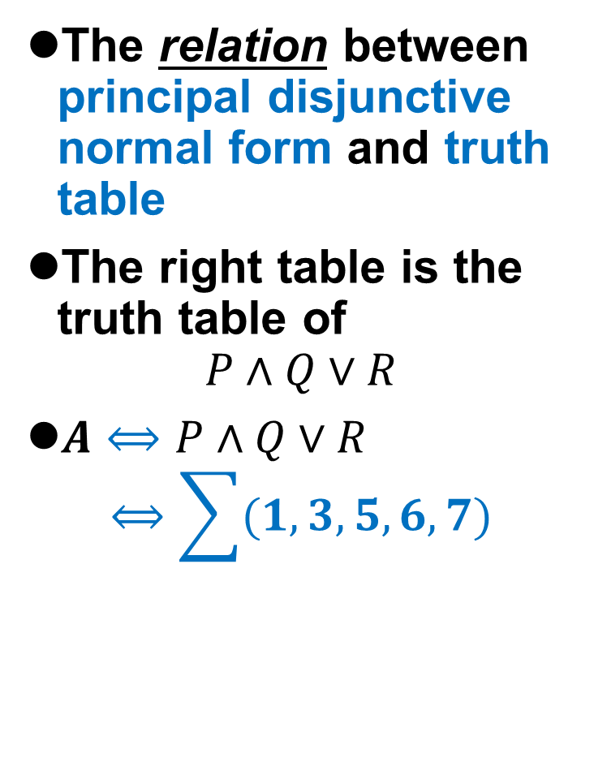
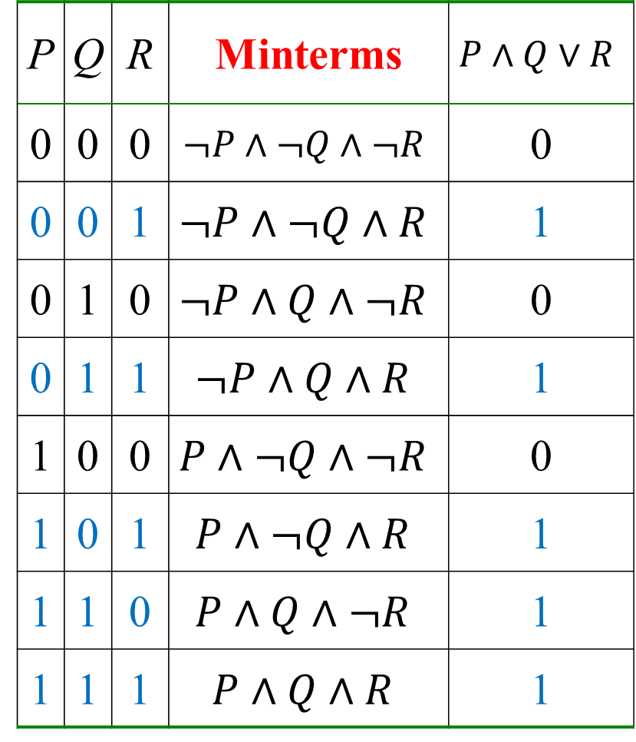
Principal disjunctive normal form
对偶原理
定义
定理1
定理2
定理3
范式和判定
概念
析取范式和
合取范式
主析取范式和
主合取范式
The relation between principal disjunctive normal form and truth table
The right table is the truth table of
$$P∧Q∨R$$
$A⟺P∧Q∨R$
$$⟺\sum{(1,3,5,6,7)}$$
P | Q | R | Minterms | $$P∧Q∨R$$
0 | 0 | 0 | $$¬P∧¬Q∧¬R$$ | 0
0 | 0 | 1 | $$¬P∧¬Q∧R$$ | 1
0 | 1 | 0 | $$¬P∧Q∧¬R$$ | 0
0 | 1 | 1 | $$¬P∧Q∧R$$ | 1
1 | 0 | 0 | $$P∧¬Q∧¬R$$ | 0
1 | 0 | 1 | $$P∧¬Q∧R$$ | 1
1 | 1 | 0 | $$P∧Q∧¬R$$ | 1
1 | 1 | 1 | $$P∧Q∧R$$ | 1
The relationship to PDNF?

Slide 38
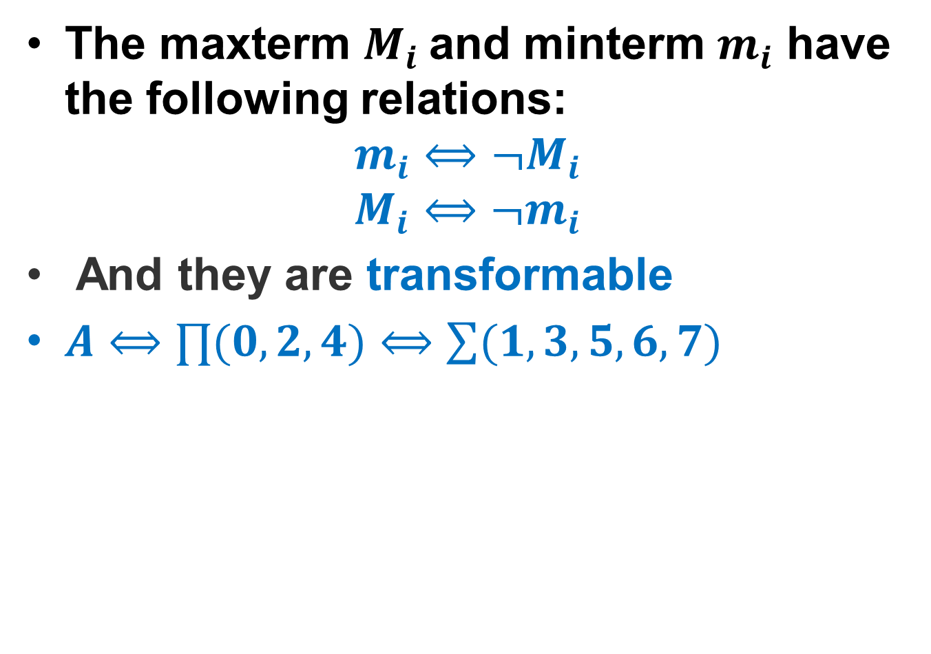
Relation between maxterms and minterms
对偶原理
定义
定理1
定理2
定理3
范式和判定
概念
析取范式和
合取范式
主析取范式和
主合取范式
The maxterm $M_{i}$and minterm $m_{i}$ have the following relations:
$$m_{i}⟺¬M_{i}$$
$$M_{i}⟺¬m_{i}$$
And they are transformable
$A⟺∏(0,2,4)⟺\sum{(1,3,5,6,7)}$

Slide 39
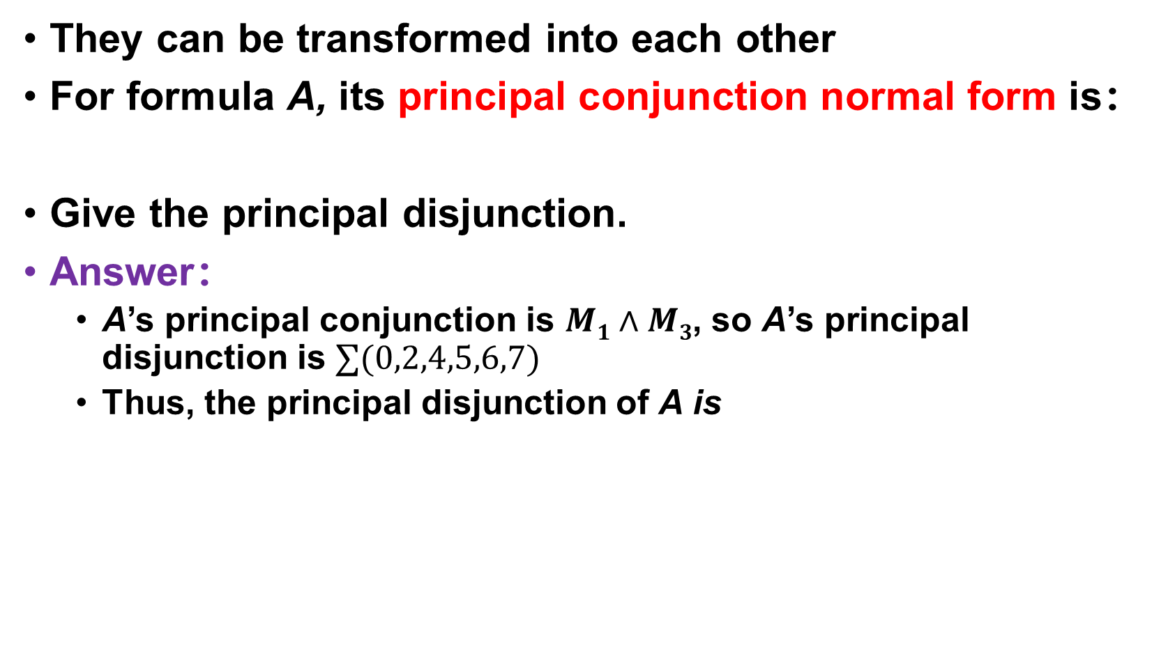
Relation between PDNF and PCNF
对偶原理
定义
定理1
定理2
定理3
范式和判定
概念
析取范式和
合取范式
主析取范式和
主合取范式
They can be transformed into each other
For formula A, its principal conjunction normal form is：
Give the principal disjunction.
Answer：
A’s principal conjunction is $M1∧M3$, so A’s principal disjunction is $∑(0,2,4,5,6,7)$
Thus, the principal disjunction of A is

Slide 40

单选题
1分
Exercise: Select the right form of M₁₁ in formula A which contains Four variables P, Q, R, S
A
¬P ∨ Q ∨ R ∨ S
B
¬P ∨ Q ∨ ¬R ∨ ¬S
C
¬P ∨ ¬Q ∨ R ∨ S
D
¬P ∨ Q ∨ R ∨ ¬S
提交

Slide 41
Principal disjunction and conjunction
对偶原理
定义
定理1
定理2
定理3
范式和判定
概念
析取范式和
合取范式
主析取范式和
主合取范式
For a propositional formula, which is permanent true（永真）, all the minterms of its propositional variables appear in its PDNF（主析取范式）, and there is no equivalent PCNF（主合取范式 ）；
For a propositional formula, which is permanent false（永假）, all the maxterms of its propositional variables appear in its PCNF （主合取范式 ）, and there is no equivalent PDNF （主析取范式） ；
For a propositional formula, which is satisfiable（可满足的）, it has the equivalent PDNF （主合取范式 ） and the equivalent PCNF （主合取范式 ）．

Slide 42
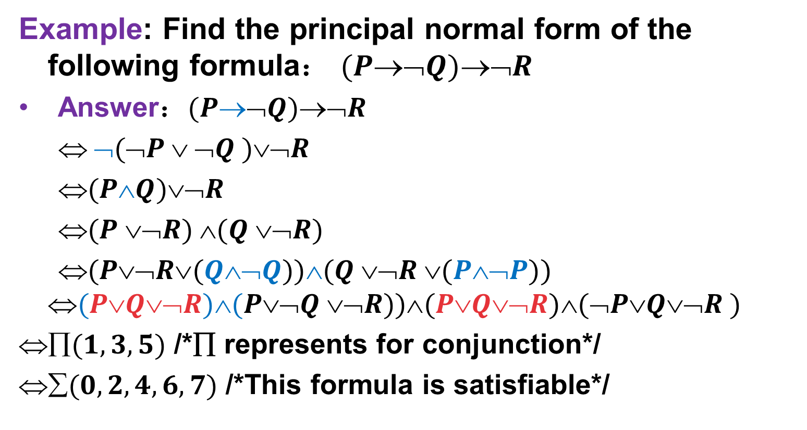
Principal disjunction and conjunction
对偶原理
定义
定理1
定理2
定理3
范式和判定
概念
析取范式和
合取范式
主析取范式和
主合取范式
Example: Find the principal normal form of the following formula： $(P➢Q)➢R$
Answer：$(P➢Q)➢R$
$ ➢(➢P  ➢Q )➢R$
$(PQ)➢R$
$(P ➢R) (Q ➢R)$
$(P➢R(Q➢Q))(Q ➢R (P➢P))$
$$(PQ➢R)(P➢Q ➢R))(PQ➢R)(➢PQ➢R )$$
$(1,3,5)$ /*∏ represents for conjunction*/
$(0,2,4,6,7)$ /*This formula is satisfiable*/

Slide 43
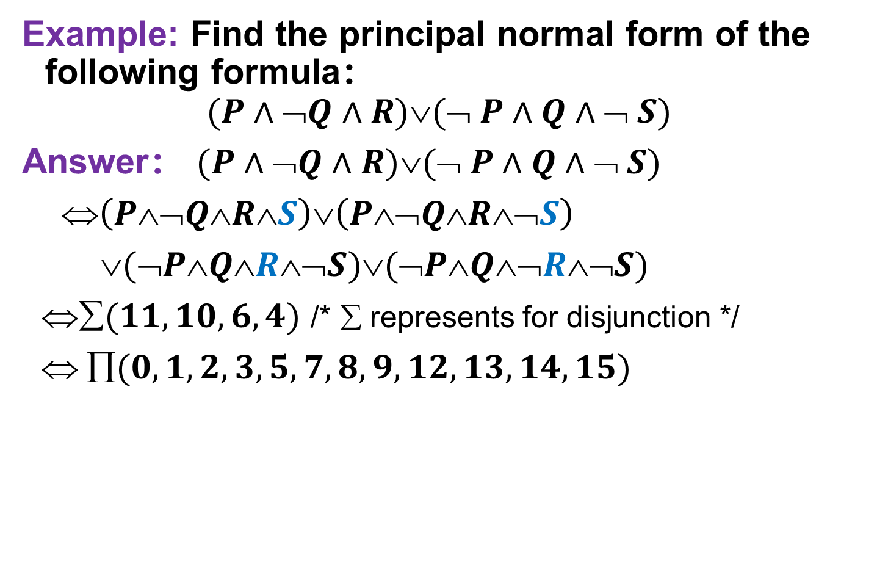
Principal disjunction and conjunction
对偶原理
定义
定理1
定理2
定理3
范式和判定
概念
析取范式和
合取范式
主析取范式和
主合取范式
Example: Find the principal normal form of the following formula：
$$(P∧➢Q∧R)(➢ P∧Q∧➢ S)$$
Answer： $(P∧➢Q∧R)(➢ P∧Q∧➢ S)$
$\left(P¬QRS\right)∨\left(P¬QR¬S\right)$
$(➢PQR➢S)(➢PQ➢R➢S)$
$(11,10,6,4)$ /* ∑ represents for disjunction */
$ (0,1,2,3,5,7,8,9,12,13,14,15)$

Slide 44
Summarization
Tips
Duality principle
Disjunctive and Conjunctive normal form
elementary product (sum)
a sum of elementary products , a product of elementary sums
Principal conjunctive / disjunctive normal form
minterm（product），maxterm（sum）， basis—binary number- decimal number - descriptor
Sum of minterms (极小项的和)，product of maxterms (极大项的积)， the relationship。

Slide 45
Summarization
Tips
Transform a formula to normal form：
(1) eliminate
(2) handle ¬
(3) Make use of Distributive Laws

Slide 46
Summarization
Tips
Transform a formula to its PDNF：
Transform the formula to its DNF；
If there is some variables appearing more than once in one elementary product, it will be absorbed to once only；
Remove the elementary products that are permanent false；
If a variable P is missing from an elementary product Q, then P can be added to Q through
Q⇔T ∧ Q⇔(P ∨ ¬P) ∧ Q⇔(P ∧ Q) ∨(¬P ∧ Q)

Slide 47
Summarization
Tips
Transform a formula to its PCNF：
Transform the formula to its CNF；
If there is some variables appearing more than once in one elementary product, it will be absorbed to once only；
Remove the elementary sums that are permanent true；
If a variable P is missing from an elementary sums Q, then P can be added to Q through
Q⇔F ∨ Q⇔(P ∧ ¬P) ∨ Q⇔(P ∨ Q) ∧(¬P ∨ Q)

Slide 48
Homework
P28
16
17(1)(3)
18(2)(4)

Slide 49

The End
Thanks

